Slide 1

IPL Data Analysis
Power BI Desktop
Objective : This Power BI project aims to analyze Indian Premier League (IPL) data, focusing on team and player performance, match outcomes, and key batting and bowling metrics. By utilizing data from multiple related tables, the analysis will provide a comprehensive view of the tournament's dynamics, uncovering insights into factors that influence success, identifying top performers, and revealing trends . The project will leverage Power BI's capabilities to visualize and interpret complex cricket statistics, offering stakeholders a data-driven understanding of the IPL's competitive landscape.

Slide 2
Power BI Desktop
Data Sources:
1. Fact Bowling
o Columns Description:
match_id: Unique identifier for the match.
match: Description or name of the match.
bowlingTeam: Name of the team that is bowling.
bowlerName: Name of the bowler.
overs: Number of overs bowled by the bowler.
maiden: Number of maiden overs bowled.
runs: Runs conceded by the bowler.
wickets: Wickets taken by the bowler.
economy: Economy rate of the bowler.
0s: Number of dot balls bowled.
4s: Number of fours conceded.
6s: Number of sixes conceded.
wides: Number of wide balls bowled.
noBalls: Number of no balls bowled.
Fact Batting Summary o Columns Description:
match_id: Unique identifier for the match.
match: Description or name of the match.
teamInnings: The team batting in the innings.
battingPos: Batting position of the player.
batsmanName: Name of the batsman.
out/not_out: Whether the batsman was out or not out.
runs: Runs scored by the batsman.
balls: Balls faced by the batsman.
4s: Number of fours hit.
6s: Number of sixes hit.
SR: Strike rate of the batsman.
Dim Match Summary o Columns Description:
team1: Name of the first team.
team2: Name of the second team.
winner: Winner of the match.
margin: Margin of victory.
matchDate: Date of the match.
match_id: Unique identifier for the match.
3. Dim Player
o Columns Description:
name: Name of the player.
team: Team the player belongs to.
battingStyle: Batting style of the player (e.g., Right-hand bat).
bowlingStyle: Bowling style of the player (e.g., Right-arm fast).
playingRole: Role of the player (e.g., Batsman, Bowler).

Slide 3







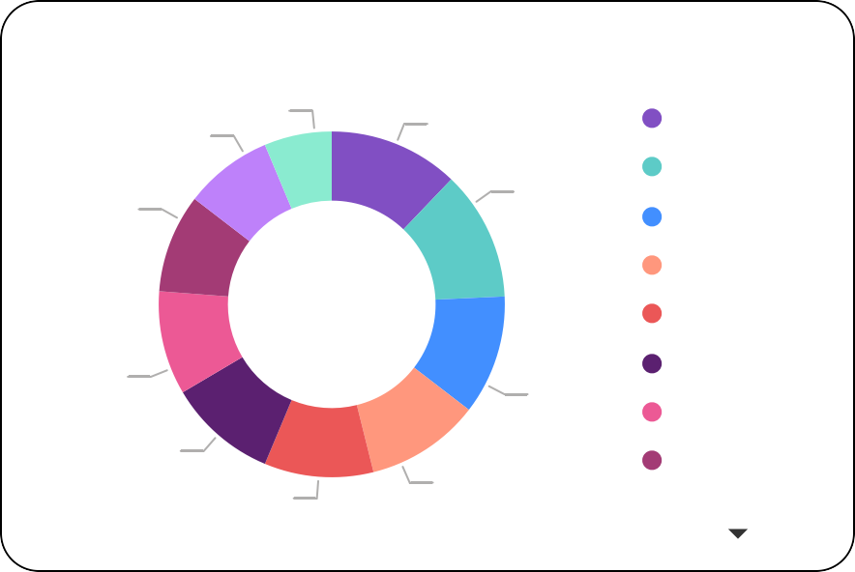
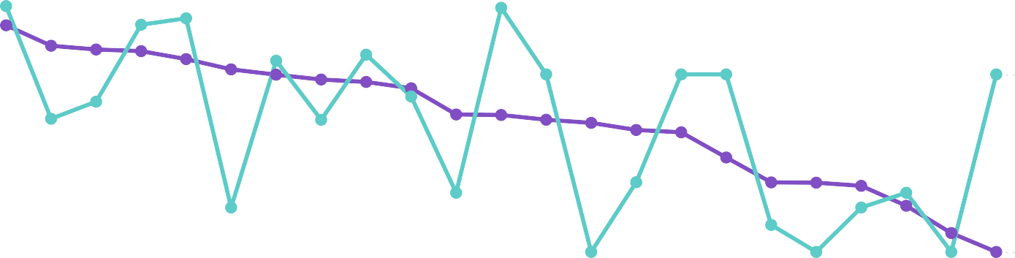
Power BI Desktop
1780
Wides
5702
Sum of 4s
2861
Sum of 6s
64772
Sum of runs
No. of wins per team
Sum of 4s and Sum of 6s by match_id
Team1
V
Team2
V
RCB
Super Kings
25
T201979 T204958
Capitals
Royals
Capitals
Royals
Titans Royals Capitals
25
T201231 T205138 T207058
23
KKR
Sunrisers
KKR
Sunrisers
22
match_id
Teams
21
T201181 T204100 T206817 T201605 T202634 T206363
KKR
Mumbai Punjab Kings Super Giants Sunrisers
21
Mumbai
Super Giants
Mumbai
Super Giants
20
19
Punjab Kings
Super Kings
Punjab Kings
Super Kings
17
13
0
10
Number of wins
20
0
50
RCB
Titans
RCB
Titans
Sum of 4s and Sum of 6s
Count of margin by winner
13
17 (8.25%) ^{(6.31%)}
19
(9.22%)
Average of runs and Average of wickets by overs
Average of runs Average of wickets
winner
RCB
Super Kings Titans
Royals
Capitals KKR
Mumbai
Punjab Kings
25 (12.14%)
25
(12.14%)
40
^{36.0032.75} 32.15 31.89 ^{1.32}
1.38 30.63
1.28
0.85
1.11
1.38
30
29.00 _{28.15 27.38 27.00 26.00}
1.08
0.88
0.74
1.00
1.00 1.00
1.00
Average of wickets
Average of runs
21.83 21.75 _{21.00}
1.0
20.50 _{19.37 19.00}
0.39
20
0.75
15.00
20
(9.71%)
11.05 11.00 10.50
0.25 7.33
0.15
0.5
23
(11.17%)
10
_{0.33} 3.00
21
(10.19%)
21 (10.19%)
0.25
0.33
0.00 0.00 0.00 0.00
22 (10.68%)
0
0.0
3.50 3.20 3.30 4.00 3.40 2.50 3.10 3.00 2.20 2.40 1.40 2.30 2.10 1.20 2.00 1.50 1.30 1.00 0.50 1.10 0.30 0.10 0.20
overs

Slide 4
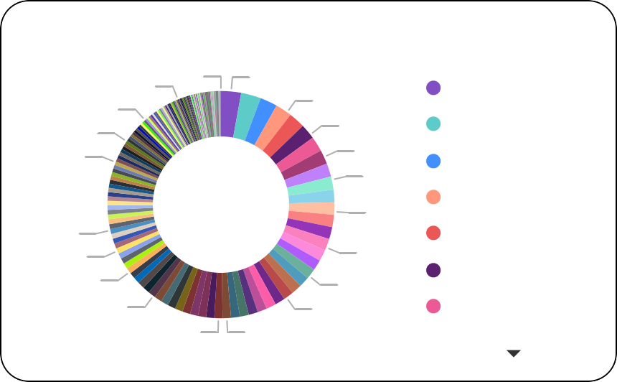
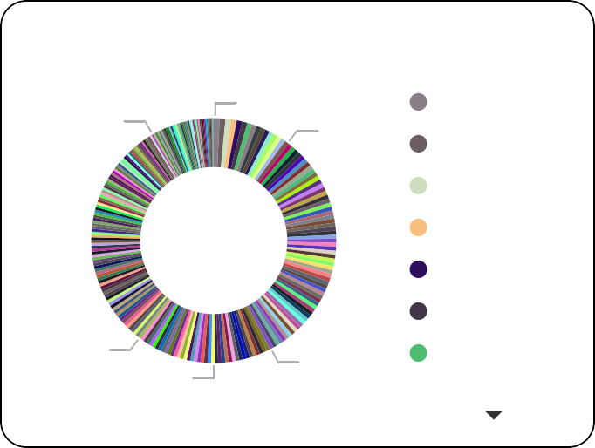
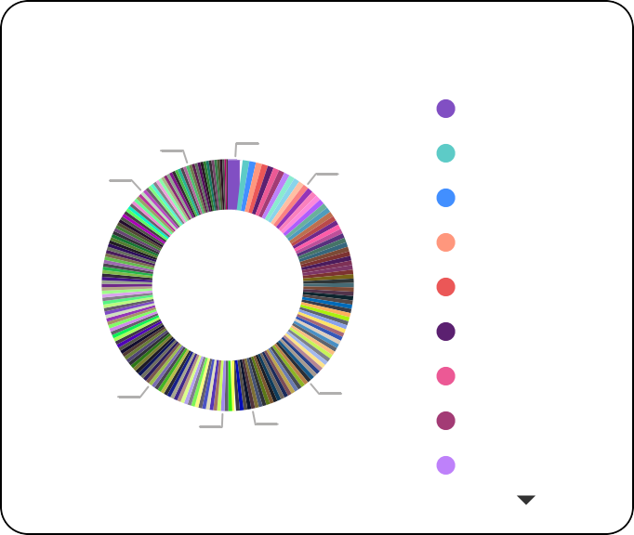
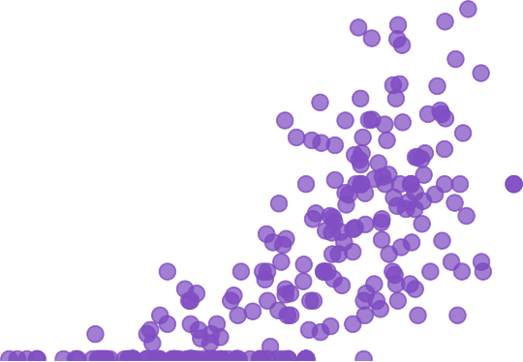
Power BI Desktop
batsmanName
V
bowlerName
V
247
No balls
2360
Wickets
All V
All V
Total runs by batsman
112.40
Average of SR
8.75
Average of economy
Sum of wickets and Sum of noBalls by bowlerName
Sum of wickets Sum of noBalls
0K (0%)
batsmanName
ShubmanGill
FafduPlessis
RuturajGaikwad KLRahul
JosButtler
ShikharDhawan ViratKohli
0K (0.17%)
0K (0.…)
0K (0…)
0K (…)
2K (2.86%)
2K (2.3…)
1K (2…)
1K (…)
1K (…)
1K
(1.7…)
1K (…)
1K (1…)
1K (1.4…)
1K (1.2%)
Average of SR by batsmanName
batsmanName
DavidWiese
Wickets and No balls
71
77
66
12 63
67
66
65
63
49 49
54
50
48
46
194.44… (0.78%)
50
43
0K (…)
1K (…)
1K (0…)
1K (1.0…)
1K (1.17%)
66.… (0…)
14… (…)
47
45 45
44
43
42
41
MarkWood
Krishnappa… HeinrichKla… Mohammad… ShashankSi… AkealHosein
0
MohammedShami
YuzvendraChahal
HarshalPatel
RashidKhan
AveshKhan
ArshdeepSingh
KagisoRabada
VarunChakravarthy
ShardulThakur
TrentBoult
RaviBishnoi
Scatter of Strike rate with Six hits
3
10… (…)
115.81… (0.46%)
120… (0.…)
bowlerName
Average of economy by bowlerName
bowlerName
YashasviJais…
Sum of 6s and Sum of 4s by batsmanName
Sum of 6s Sum of 4s
2
7.24… (0.3…)
7.… (…)
36 (1.89%)
13.5 (…)
RohitSharma
DewaldBrevis BenStokes KulwantKhej… MohitRathee RiyanParag GurnoorBrar VivrantShar…
Sixs and fours
Sixs
200
169
152
108
143
113
64 121
59 102
186
1
64 45
61 52
56 52
0
72
72
67
67
67
56
FafduPlessis
JosButtler
GlennMax…
RuturajGaik…
SanjuSams…
AndreRussell
KLRahul
ShivamDube
NitishRana
ShimronHe…
ShubmanGill
8.… (…)
9.1650… (0.48%)
9.… (…)
9.325… (0.4…)
0
0
50
100
Strike rate
150
200
batsmanName

Slide 5
KEY INSIGHTS
Power BI Desktop
Super kings and RCB are the teams with the most number of wins
The number of 4s hit in a match is generally more than the number of 6s
Sunil Narine has a good bowling economy despite having bowled nearly 1000 balls
The victory distribution is similar for almost all teams.: Super Kings and RCB have the highest number of wins and SRH has the lowest number of wins
David Wiese have the highest average strike rate, though Subhman Gill Have highest to total runs
Yashasvi Jaiswal have highest economy rate while Mohammed Shami Have highest wickets.
There is a weak position correlation between strike rate and sixs hit

Slide 6
THANK YOU
Power BI Desktop

